Slide 1

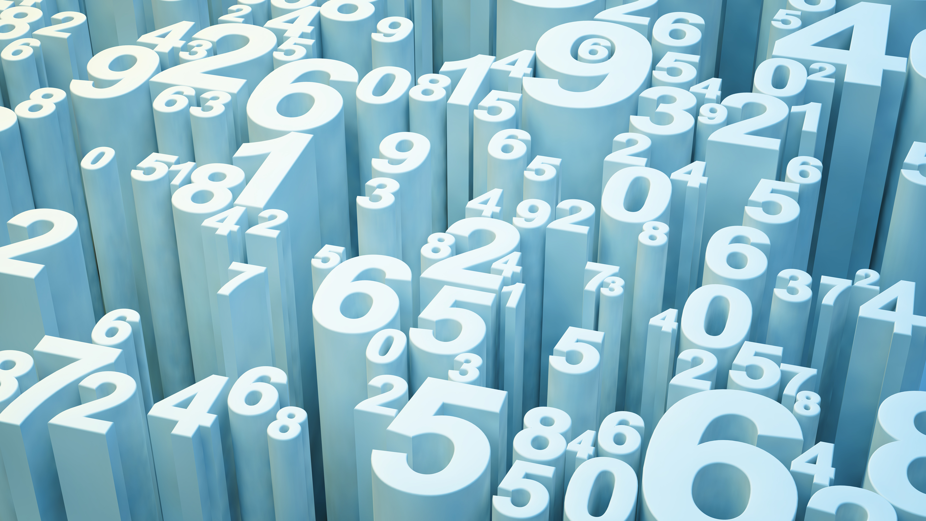
Text to Speech (Python Solo Project)
By: Lokesh Garg
2210990544
To: Tushar Khitoliya

Slide 2
Introduction
The Text to Speech Application has been build on the basis of converting any written text into a well known language for the purpose of hearing, removing the need of a mediator to translate it for you.
This project aims to convert text into spoken audio using Python's gTTS library. GTTS stands for Google Text-to-Speech and provides a convenient interface to interact with Google's Text-to-Speech engine.

Slide 3
PROBLEM STATEMENT
Most of the time when you are out on a trip, and there is a native that you want to talk to but are unable to because of the language barrier between you and the native.
This is a problem faced by a lot of people nowadays who want to go out explore the world but decide not to due to these language barriers.

Slide 4
OBJECTIVE
The objective of the Text to Speech Application is to provide users with a simple and efficient tool to convert any text to an audio of any language they want, thereby removing these language barriers and assuring users to not to worry when trying to communicate to a native.

Slide 5
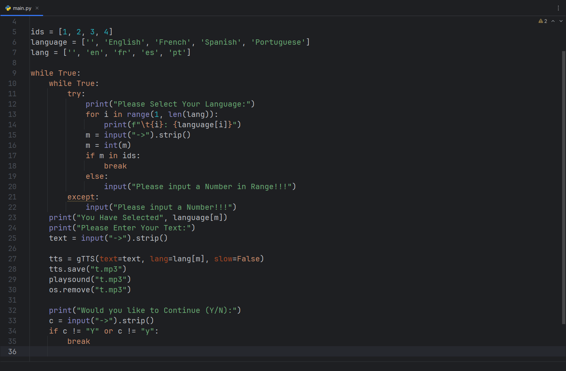
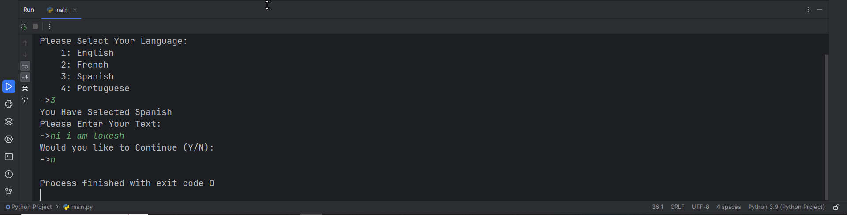
Snippets

Slide 6
References
https://www.w3schools.com/python/
https://gtts.readthedocs.io/
https://pythonbasics.org/python-play-sound/

Slide 7
Thank You

